Slide 1

Betbook
A mobile application based on swift
Cimbelli Alessandro
Daverio Matteo

Slide 2
INTRODUCTION

Slide 3
What it is and what is used for
Application to support people who want to bet on football events
Gives information about bet coverage, quotation of teams and their performances

Slide 4
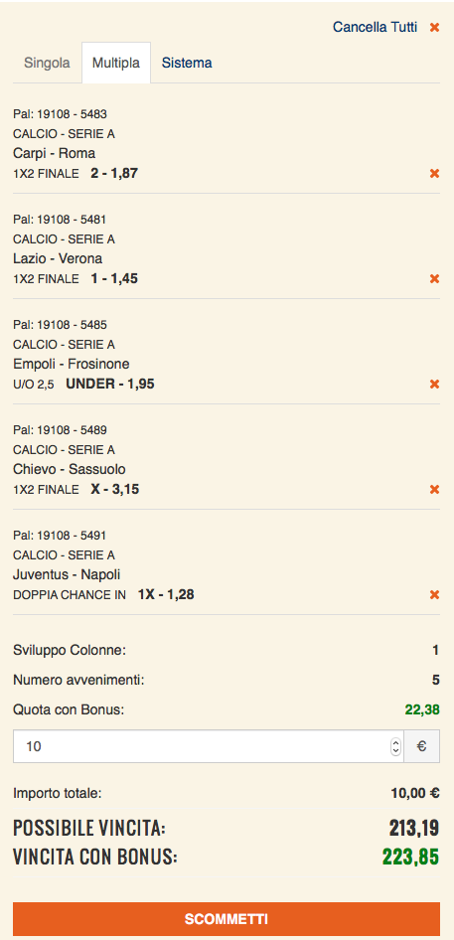


What it is a bet coverage
Matches that have being played and guessed
You might be wondering some of the following questions…
How do I cover my bet?
How much am I going to win? (Bounds: (Max,Min))
How much I need to bet on the coverage?
Last match to guess to win the bet!
The answer is….Betbook!

Slide 5
functionalities

Slide 6
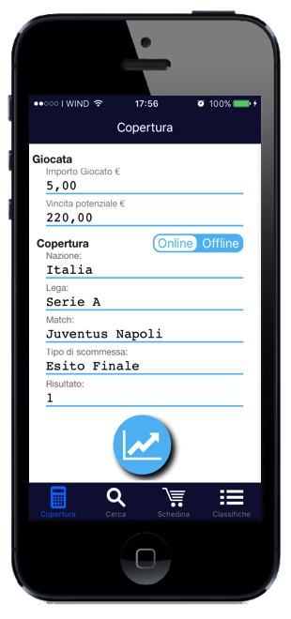
Bet coverage
Insert the bet using pickers
User can insert all the data about his bet, in a user friendly way
Switch to choose the modality
Button to go to the graph

Slide 7
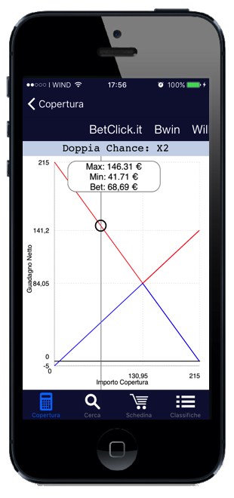
In online coverage, user can see the kind of bet he has to do
Using a chart, the app shows how user can bet.
This functionality can be used either online or offline
Charts display max and min win for every possible bet

Slide 8
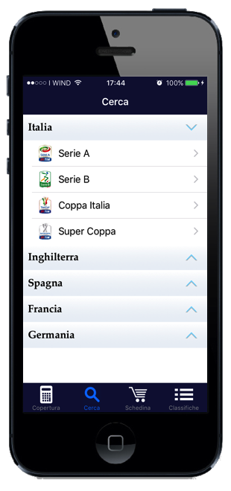
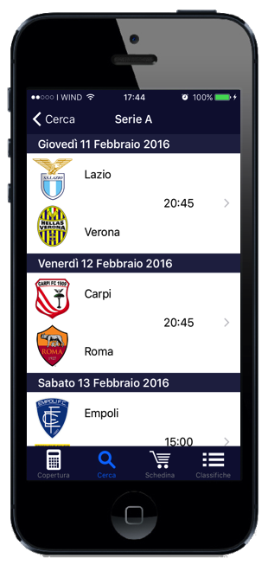
Event viewer
User can select the league through an accordion menu and then can look at the events scheduled

Slide 9
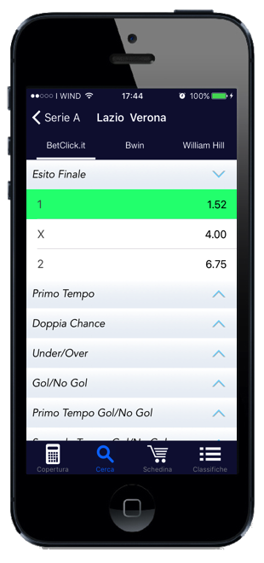
Quote viewer
User can change the odds’ provider
Green events are in the betting pool
User can see the details for the selected match and can also put that event into the betting pool

Slide 10
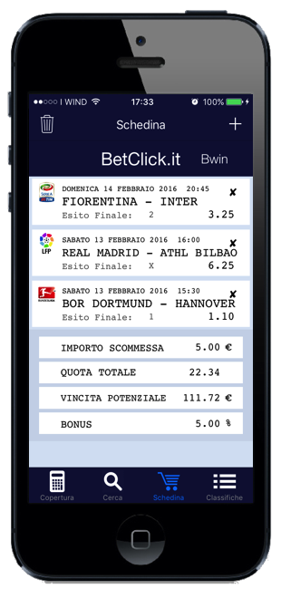
Betting pool viewer
To delete the betting pool
To add a new event
Here user can manage their betting pool
To delete a single event
User can modify the import and the bonus of the bet, the other data will update automatically

Slide 11
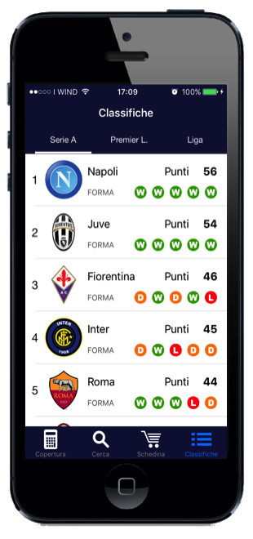
Leaderboard viewer
Leaderboards display the team’s standings
User can select the league
User can see the leaderboard with some information about teams

Slide 12
Design decisions

Slide 13
multithreading
Why Multithreading?
Because we don’t want to block the main queue’s thread freezing the Ui while we do external requests. We would like to do our URL request in a different thread.

Slide 14
multithreading
Example of a multithreaded iOS API
This API lets you fetch something from an http URL to a local file Obviously it can’t do that on the main thread!
let session = NSURLSession.sharedSession()
if let url = NSURL(string: “http://url”) {
let request = NSURLRequest(URL: url)
let task = session.dataTaskWithURL(url!){ (data: NSData?, respons: NSURLResponse?, error: NSError?) -> Void in
//Code on data retrieved from the external service
self.delegate?.setMatchList(list)
}
task.resume()
}

Slide 15
multithreading
How to do UI stuff safely
We simply dispatched back to the main queue the operations about UI updates
func setMatchList(matchList: [Match]?){
dispatch_async(dispatch_get_main_queue()){ () -> Void in
if( matchList == nil){
//Display Alert Message
}else{
self.matches = matchList
self.spinner.stopAnimating()
self.refreshControl?.endRefreshing()
self.tableView.reloadData()
}
}
}

Slide 16
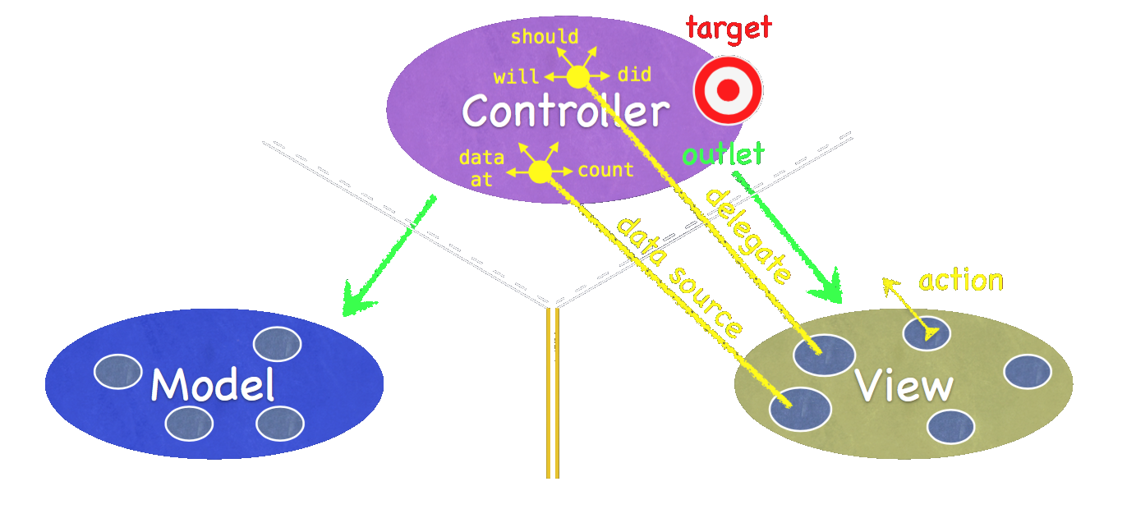
Model - view - controller
Divide classes into 3 main areas
Models and views need to be independent
Model: what the application is
Controller: how model is presented to the user
View: controller's servant

Slide 17
Mvc: why we used it
It is one of the best practice for professional programming in an object oriented environment
This pattern gave to each member of the team a common point of view on how to develop the project
It separates business logic from UI, so code is cleaner and easier to maintain and debug
Good reusability for model classes

Slide 18
Persistence
Used to save in a persistent way betting pools
Use of NSUserDefaults, because data are simple and small

Slide 19
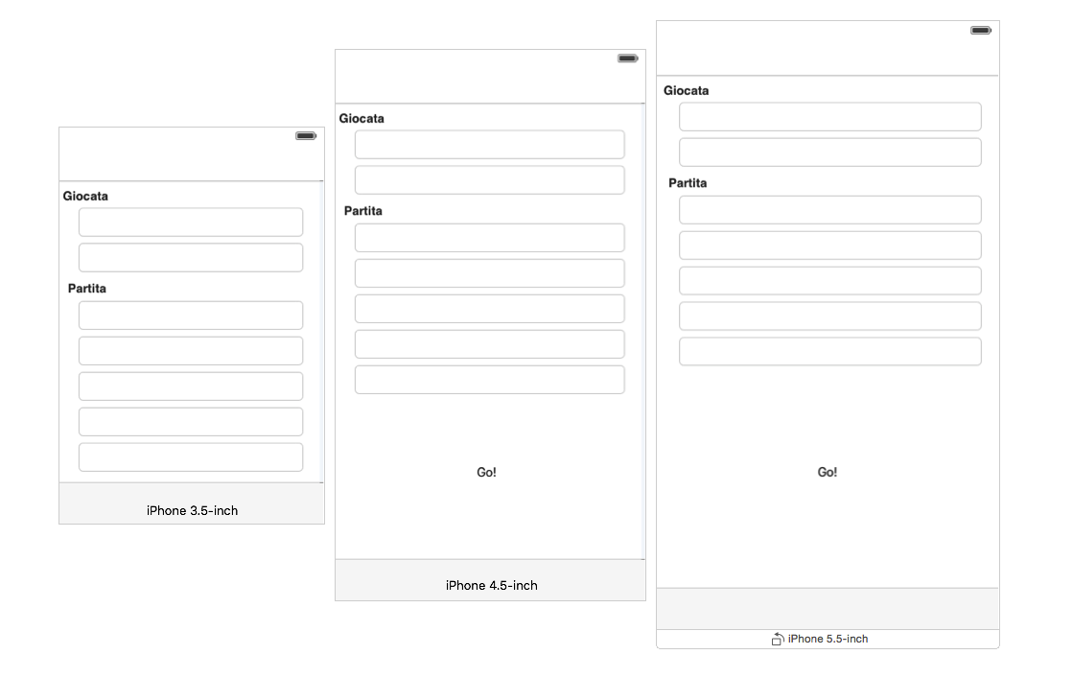
layout
This app is created for all iPhone devices
Layout is designed to be efficient on every screen dimensions

Slide 20
Thanks for watching!
Now it's demo time.

